Slide 1



Welcome to Hour of Code™
Welcome to
Minecraft Hour of Code™
Notes:
The following presentation is meant to be used for youth between 11 and older. We recommend 90 minutes for the presentation, guided discussion, videos, and student coding activity.
SAMPLE SCRIPT:
“Hello! I’m <name>, from <organization>. Welcome to this year’s Hour of Code! Hour of Code is a worldwide campaign by Code.org to demystify code and show that anybody can learn the basics. Today, you’ll be a part of that effort, doing the new Minecraft Hour of Code tutorial from Microsoft. Before that, we’re going to talk a little bit about what coding actually is, why it matters, and how it can have a positive impact on your life!”
SLIDE GOAL:
To get participants excited for Hour of Code!
FACILITATOR NOTE:
Most of the slides in the event presentation deck are designed to be shown briefly, only a few seconds in most cases, to provide strong visual enhancement to a rapid and conversational presentation you are making to the audience.
IMAGE INSTRUCTIONS FOR THIS SLIDE:
This image represents worldwide participation in Hour of Code events.

Slide 2

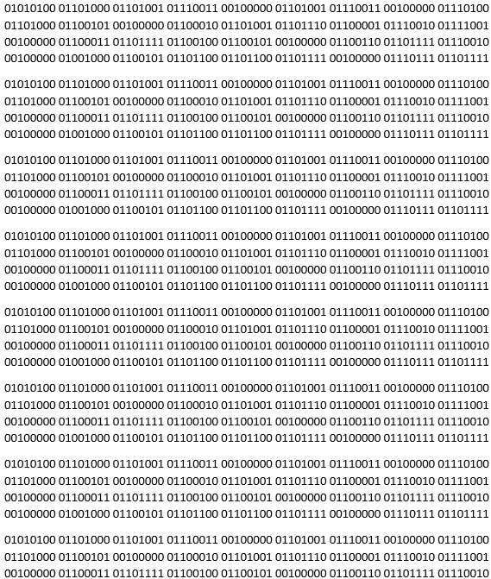
Let’s talk about coding
Before we get started, let’s talk about coding.
Notes:
SAMPLE SCRIPT:
“You might already know that coding is what people use to give technology instructions. Computers don’t understand English, so we have to give them commands in a language that they’ll get. That language is code! What you might not know is that coding is not just for software engineers and people in the tech world. Coding is an awesome skill that anyone can learn!”
FACILITATOR NOTE:
The video will play automatically when you move on to the next slide.
SLIDE GOAL:
The following section is meant to change the misconceptions associated with coding amongst many young people.
IMAGE INSTRUCTIONS FOR THIS SLIDE:
This is an image of “The binary code for Hello world” repeated 8 times.

Slide 3


What do you know about "coding?"
When you
hear the term “coding”, what do you think of?
Take 2 minutes to tell your friends, and then let the whole group know!
Question
Notes:
SAMPLE SCRIPT:
“What do you think of when you hear ‘coding’? Take a few minutes to think about “coding” and what it means to you.”
[prompt for discussion]
“Now let’s watch a short video that shows you just how popular coding has become, and how many young people, like you, have tried it!”
SLIDE GOAL:
Goal: to prompt a discussion and gauge what preconceived notions young people might have about coding. We know there are some general misperceptions about coding and computer science: That it is only for those good at math, “geeks”, or is mostly for boys. In the next slides, we’ll correct any misperceptions about coding to change the participants view before we move into the tutorial.
FACILITATOR NOTES:
Careful, don’t reinforce myths by prompting with them. Ask your group what they think! You may be surprised!
“First, we’re going to watch a short video that shows you just how popular coding has become in the past few years, and how many young people, like you, have tried it!”

Slide 4
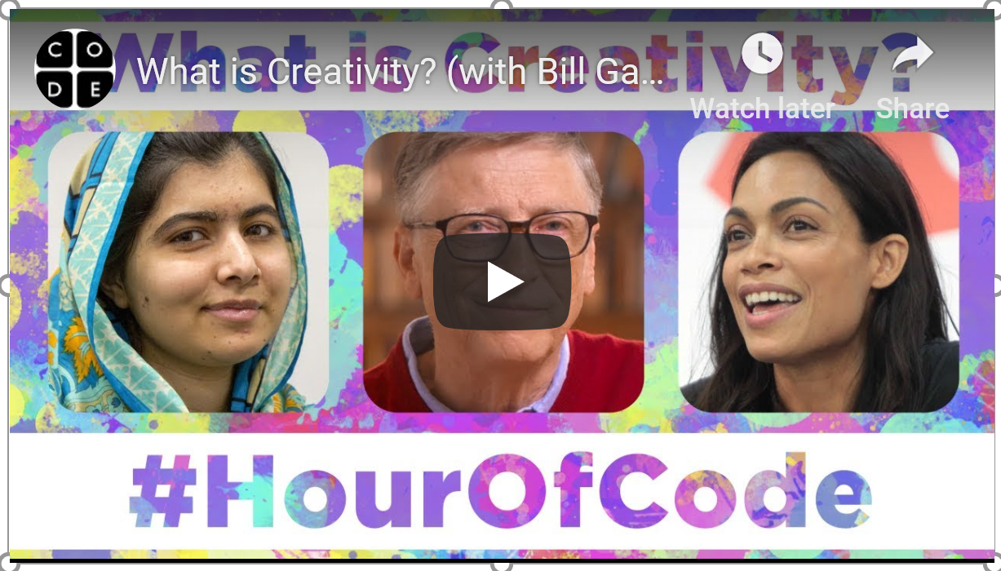

Hour of Code™ video by Code.org
Notes:
SLIDE GOAL:
To get young people excited about the Hour of Code tutorial.
IMAGE INSTRUCTIONS FOR THIS SLIDE:
The video should play automatically.
If you’d like to change the language or the subtitles, you can do so at the below link by clicking the ‘settings’ gear in the lower right hand corner of the video. You may need to re-embed the link if you do: https://www.youtube.com/watch?t=1&v=2DxWIxec6yo
Additional videos can be located at code.org, and substituted if you are looking for a different message for your audience.

Slide 5

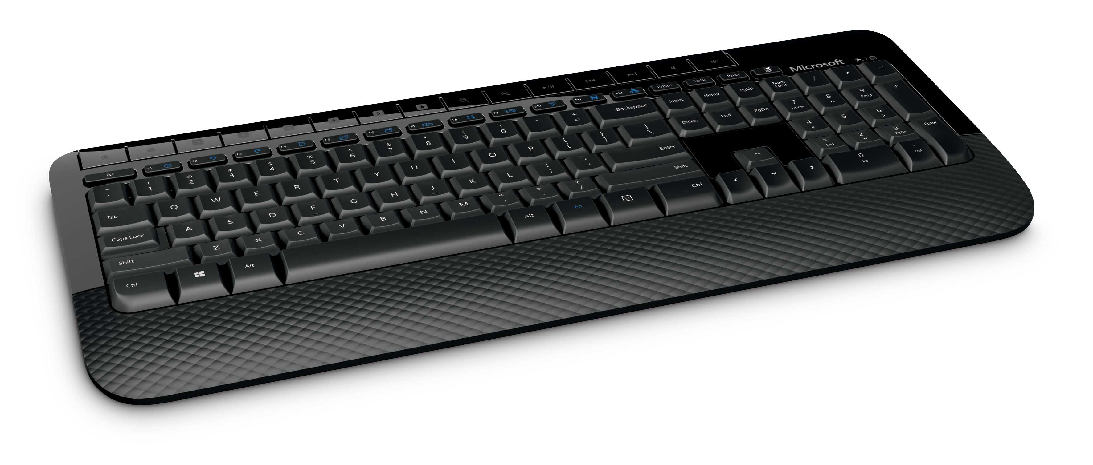

It’s not this
It’s not this.
Notes:
SAMPLE SCRIPT:
“Let’s talk about what coding isn’t. Coding isn’t something that you have to do on your own, and it’s not as hard as you might think it is!”
SLIDE GOAL:
Slides 5-8 are meant to break down the preconceived notions young people aged 11-14 have on what people who code look like, and what coding is actually is. We really want to help these young people break the stereotypes by letting them know that coding isn’t:
A solitary activity
A masculine activity
Only for “geeks”
Only for people who are good at math
Just for people that want to develop computer programs

Slide 6
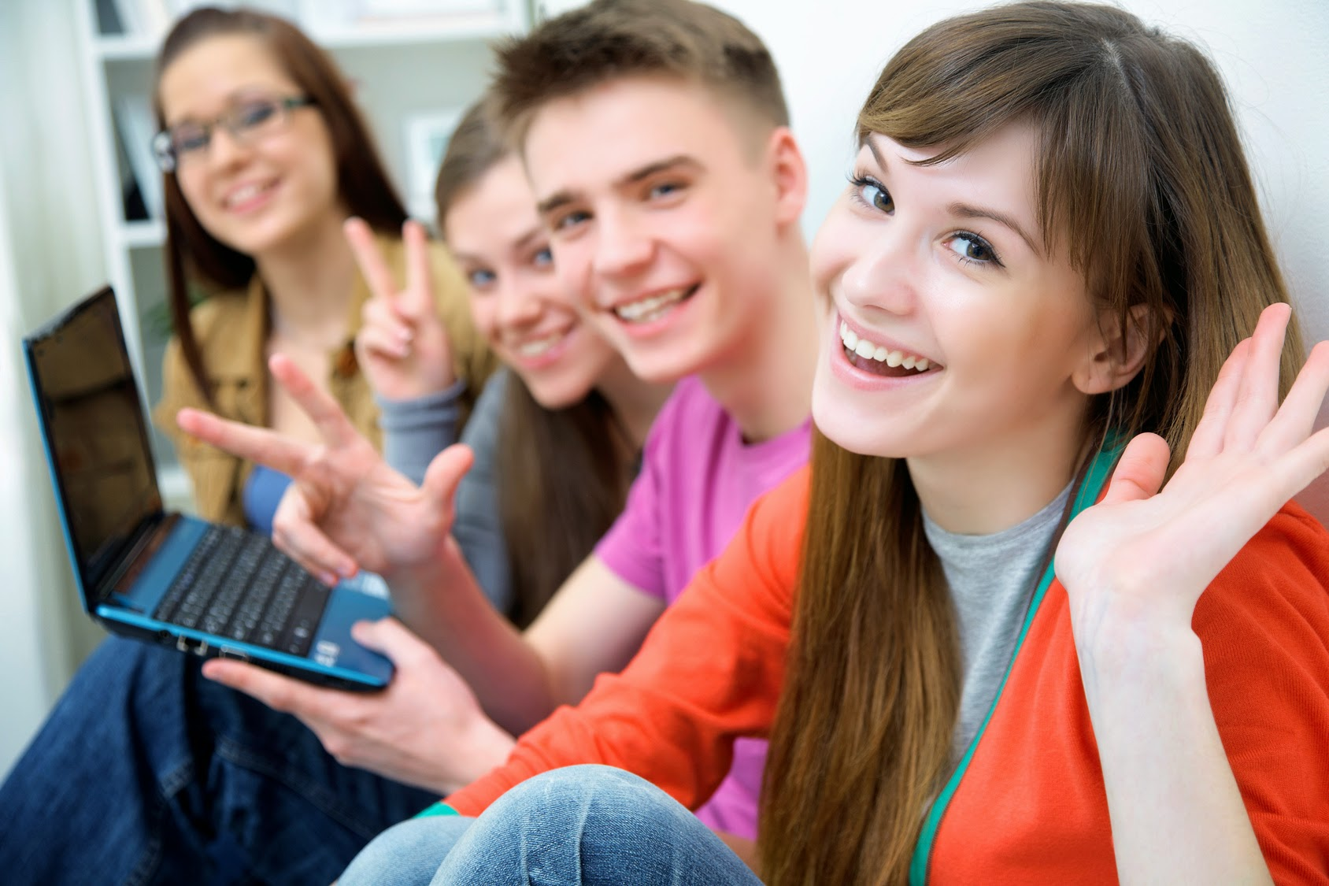
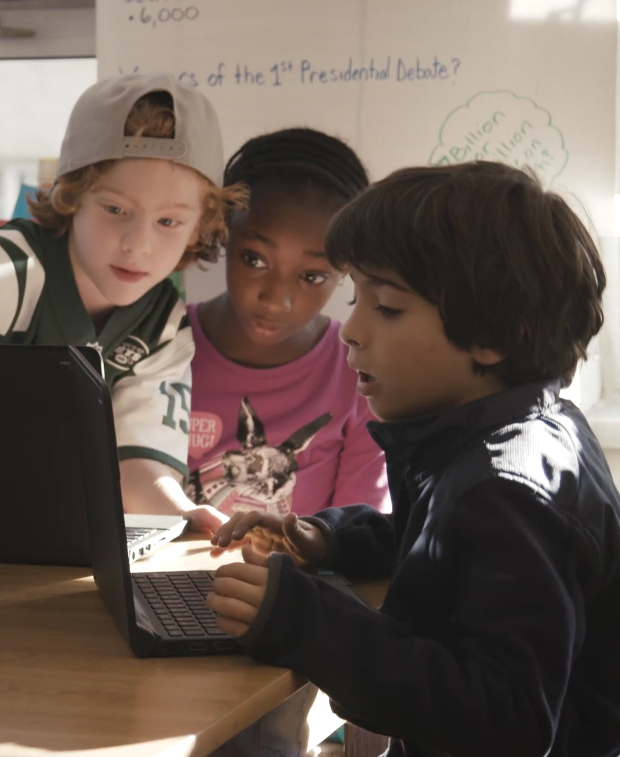

It’s not this, either
It may be this.
Notes:
SAMPLE SCRIPT:
“Coding also isn’t sitting at a desk by yourself for hours on end! Diverse coding teams make better solutions and better software products.
SLIDE GOAL:
Coding is for everyone. Diverse coding teams make better software products.

Slide 7

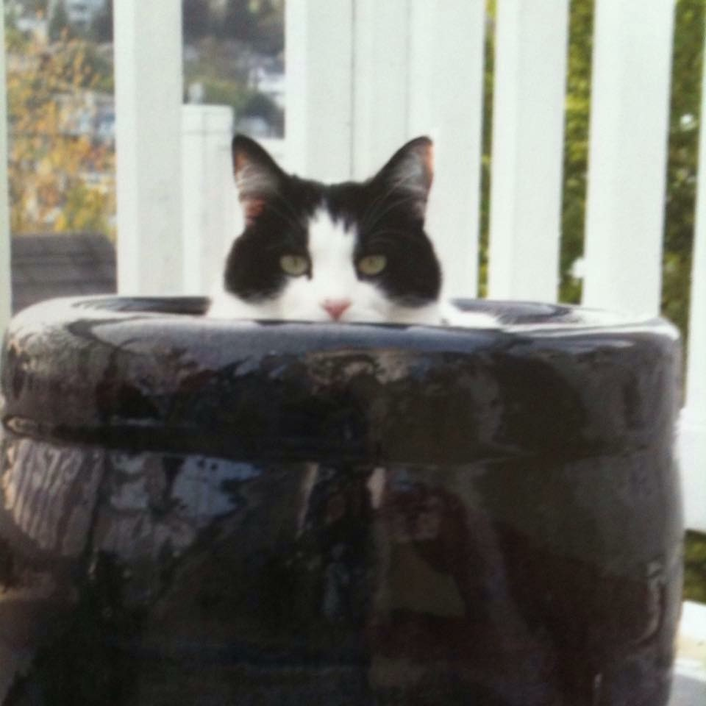
It's this!
It’s this.
Notes:
SAMPLE SCRIPT:
“What you might not know is that coding is actually really helpful in the workplace…”
SLIDE GOAL:
To make people laugh, this slide is a joke and just for fun!
IMAGE INSTRUCTIONS FOR THIS SLIDE:
The image for this slide should just be a silly image or .gif to keep the audience engaged.

Slide 8

Just kidding
JK…
Notes:
SAMPLE SCRIPT:
“Just kidding!”
SLIDE GOAL:
To reveal that the previous slide was a joke.

Slide 9

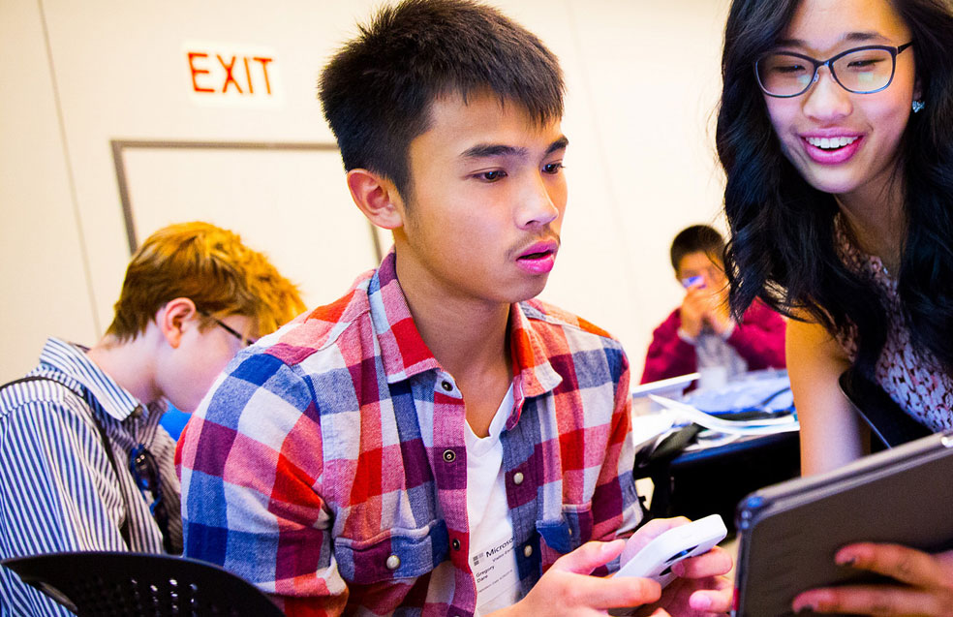
It's actually this
It’s this.
Notes:
SAMPLE SCRIPT:
“Now, let’s talk about what coding actually is. You might not know this but it’s a collaborative activity, and it’s for boys and girls!”
SLIDE GOAL:
In slides 9-12 we’re visually showing young people the fun that can be had with coding. We really want to emphasize that coding is:
Collaborative
Any gender
For introverts and extroverts
About problem solving. Coding actually involves very little math.
For people that want to use computers to help them amplify their passions
IMAGE INSTRUCTIONS FOR THIS SLIDE:
If this image is to be swapped out, make sure it fits the following criteria:
Contains youth of early teens/middle school age
Shows the participants having a good time with technology
Contains a group of people, not just individuals
Includes females

Slide 10
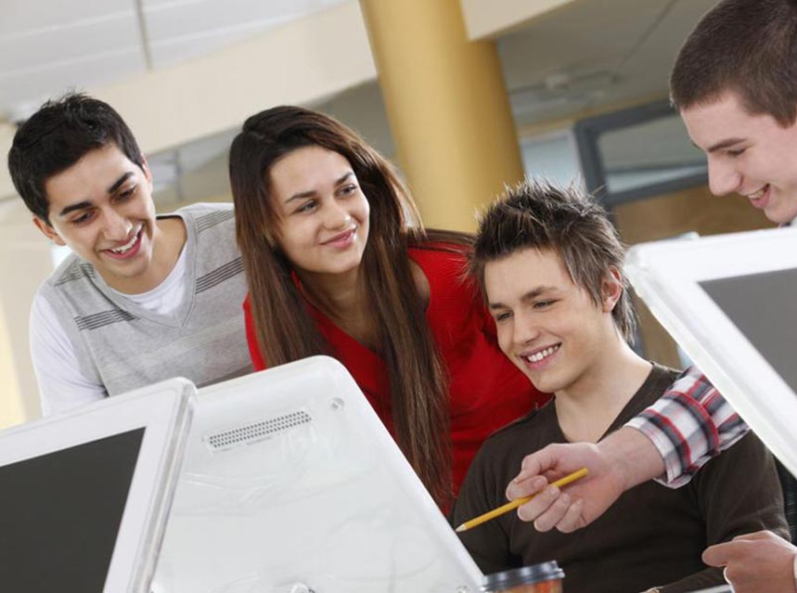
And this
It’s this.
Notes:
SAMPLE SCRIPT:
“It’s also something that can help you accomplish many goals, like creating a blog, website, or app with your friends.”
SLIDE GOAL:
In slides 9-12 we’re visually showing young people the fun that can be had with coding. We really want to emphasize that coding is:
Collaborative
For any gender
For introverts and extroverts
About problem solving. Coding actually involves very little math.
For people that want to use computers to help them amplify their passions
IMAGE INSTRUCTIONS FOR THIS SLIDE:
If this image is to be swapped out, make sure it fits the following criteria:
Contains males and females of early teens/middle school age
Shows the participants having a good time with technology
Contains a group of people, not just individuals

Slide 11
Coding is about
Coding is about…
Notes:
SAMPLE SCRIPT:
“Now, let’s really dive into what coding is all about.”
SLIDE GOAL:
To set up the following section, and get young people excited about what coding actually is.
IMAGE INSTRUCTIONS FOR THIS SLIDE:
N/A

Slide 12
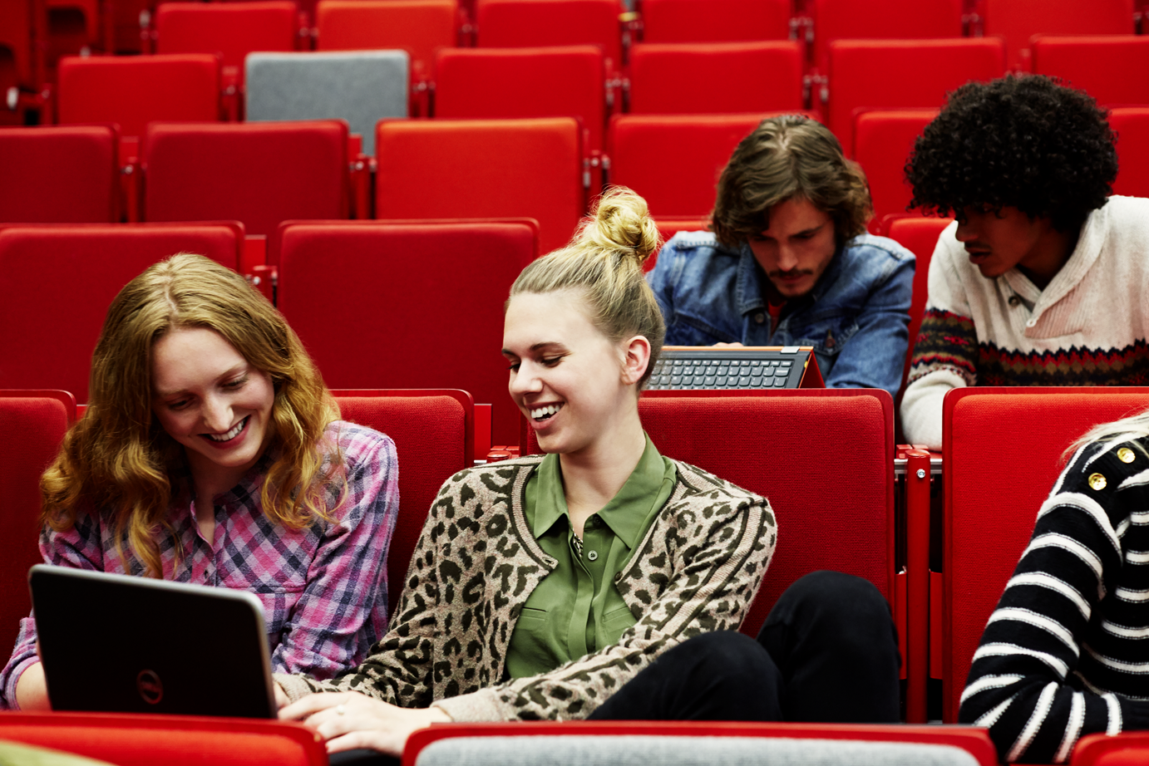

Problem solving
Problem solving
Notes:
SAMPLE SCRIPT:
“Coding isn’t just about writing a program, or giving a computer instructions. It’s about working with friends to solve a problem in a new way.”
SLIDE GOAL:
To show young people that coding takes an active mind that likes puzzles, fixing things, and finding solutions.
IMAGE INSTRUCTIONS FOR THIS SLIDE:
If this image is to be swapped out, make sure it fits the following criteria:
A group of young people working together while looking at a computer or tablet.

Slide 13


Creativity
Creativity
Notes:
SAMPLE SCRIPT:
“It’s about combining your creativity with the power of computers to create something that you’re excited about.”
SLIDE GOAL:
To continue to expand young people’s thinking on what coding can be associated with.
IMAGE INSTRUCTIONS FOR THIS SLIDE:
If this image is to be swapped out, make sure it fits the following criteria:
An art form not usually associated with coding, like music or visual arts.

Slide 14
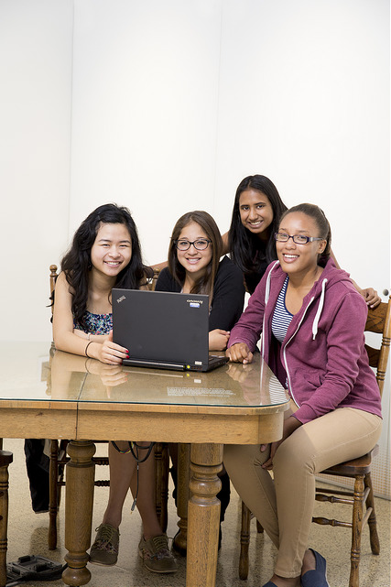

Collaboration
Collaboration
Notes:
SAMPLE SCRIPT:
“It’s also about working together to create something new!”
SLIDE GOAL:
To correct the misconception that coding is usually something that’s done totally alone. Anyone can code, it’s something that’s approachable, and fun.
IMAGE INSTRUCTIONS FOR THIS SLIDE:
If this image is to be swapped out, make sure it fits the following criteria:
A group of young people together, having fun.

Slide 15
What do you love to do?
What’s something that you and your friends love to do?
Question
Notes:
SAMPLE SCRIPT:
“What do you like to do with friends? It can be anything at all - volunteering, sports, fashion, video games.”
SLIDE GOAL:
To position coding as a social activity, which is more likely to get young people them invested.

Slide 16


Bring your interests to life
Whatever your interests are, coding can help you bring them to life.
Notes:
SAMPLE SCRIPT:
“Coding can actually be relevant to all of the things you like to do!”
*EXAMPLES TO MENTION
If someone cares about video games, they can use coding to make their own.
People that care about fashion can build their own blog that promotes their own curated fashion tips.
Participants that care about literature can build a site that shares their ‘must reads’ of the month and their personalized reviews.
SLIDE GOAL:
Given the importance that social clout has at this age, it is important to reflect that coding can be applied to any aspect of life, and it is not a deviation from the norm.
IMAGE INSTRUCTIONS FOR THIS SLIDE:
For this image we’ve included a sparkler, to emphasize the “spark” of a new understanding of coding.
If this image is to be swapped out, make sure it fits the following criteria:
An image or .gif that represents starting something new, or expanding horizons.

Slide 17

Apply your learning
While you are doing your Minecraft Hour
of Code,
keep in mind how you could apply what you are learning to what you love to do.
Notes:
SAMPLE SCRIPT:
“We’re going to be starting soon, so I want you to think about everything we’ve talked about while you’re playing, and think about how you can apply coding to your everyday life.”
SLIDE GOAL:
To ensure that students think about everything they’ve seen on the presentation while they participate in Hour of Code.
IMAGE INSTRUCTIONS FOR THIS SLIDE:
For this image we’ve included the image of a photographer, to re-emphasize that coding can be useful to various interests.
If this image is to be swapped out, make sure it fits the following criteria:
An image or .gif of something that is not usually associated with coding.

Slide 18
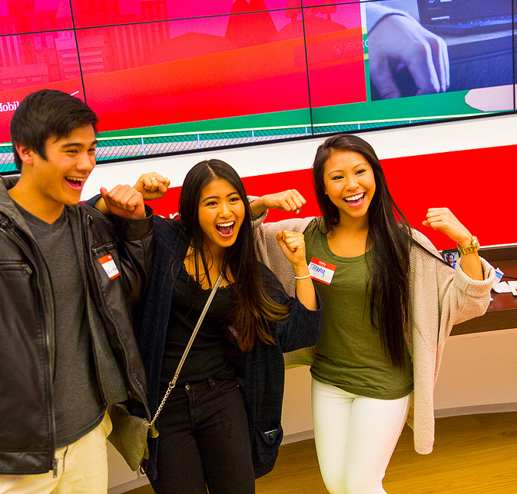
How it goes down
Minecraft
Hour of Code:
how it goes down!
Notes:
SAMPLE SCRIPT:
“Alright, lets get started!”
SLIDE GOAL:
To introduce Hour of Code.
IMAGE INSTRUCTIONS FOR THIS SLIDE:
If this image is to be swapped out, make sure it fits the following criteria:
An image or .gif of young people that are visibly excited.

Slide 19
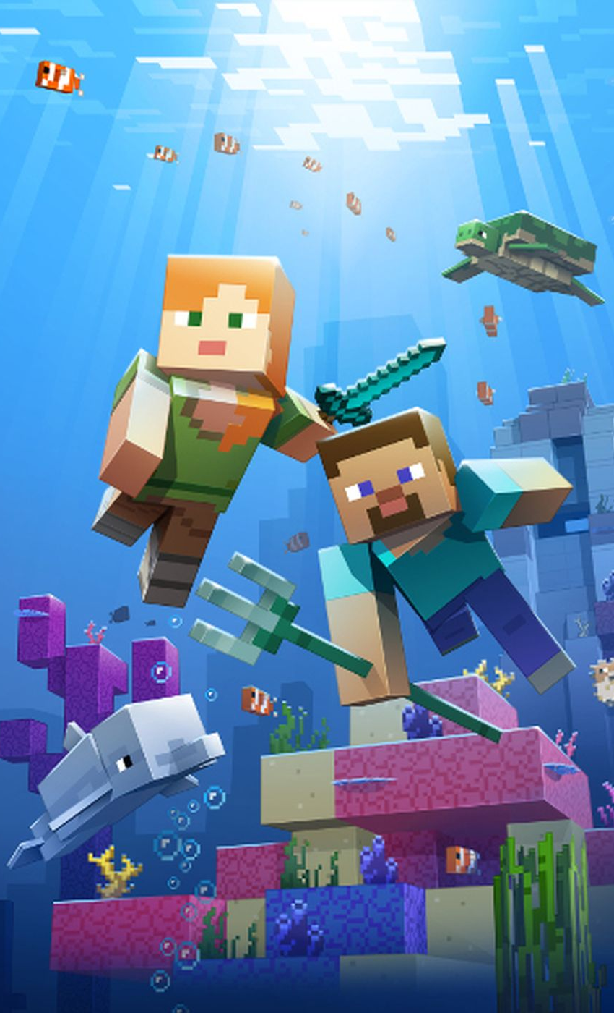
How it goes down
Minecraft Hour of Code:
Voyage Aquatic
Notes:
SAMPLE SCRIPT:
“Are you ready to start coding? Let’s get started! “For today’s Hour of Code, we’re going to learn with a Minecraft game-inspired tutorial! The tutorial uses characters and concepts from the Minecraft video game, but it is not the game itself. In the Minecraft Hour of Code tutorial, you will head underwater and will learn and use coding techniques like loops and conditionals to design your own solutions as you explore by land and by sea.
SLIDE GOAL:
To introduce Hour of Code
FACILITATOR NOTE:
There is more than one Minecraft tutorial. Start with this year's tutorial and utilize the other tutorials, if they finish early. Each tutorial teaches different concepts so doing all of the tutorials is a great idea!
If you cannot give each participant their own device, try and pair them up with someone and have them rotate every step of each lesson so they both get a chance to be active and observe. We suggest individuals work alone on the puzzles.
After fifteen minutes, congratulate the group for the progress made and the code they have written.
For participants who complete the tutorial and/or are more advanced, invite them to play through the tutorial rescuing turtles along the way, these are secondary and more challenging objectives on some of the levels
Finally, for those who want to shortcut the Hour of Code, Puzzle 4 heads straight to some levels about loops and Puzzle 7 heads straight to levels focused on conditionals

Slide 20
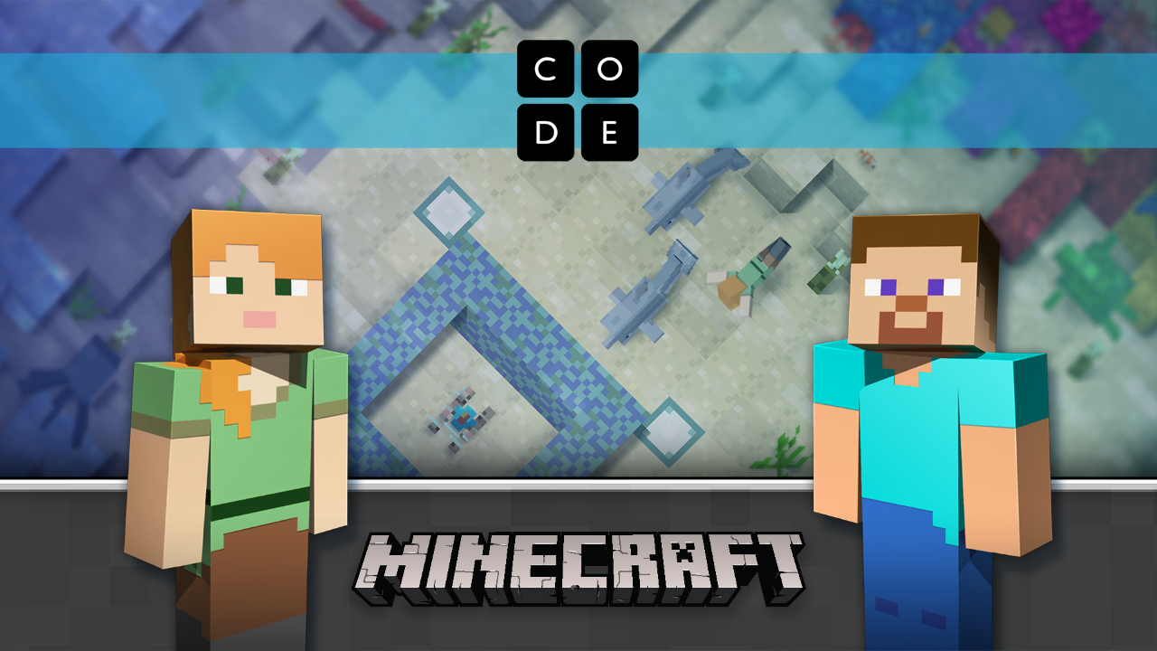
Find your tutorial
Find the tutorial at Code.org/Minecraft
Notes:
SAMPLE SCRIPT:
“Now go to code.org/Minecraft to find the “Minecraft Hour of Code Voyage Aquatic” tutorial and BEGIN! ”
SLIDE GOAL:
To give people time to get to the tutorial.
FACILITATOR NOTE:
Keep this slide up during the tutorial, and proceed to the next slide only once your group nears the end of their tutorial
If participants sign into the tutorial, progress will be saved on the levels and they can come back if they don’t finish.
Since there is free play and space to construct anything one wants, be aware of the risks associated with youth and user generated content.
IF YOU HAVE LIMITED TIME:
Complete as many puzzles as you can. Tech savvy kids may complete them all in 50-60 minutes.
Congratulate the students for what they accomplished, and let them know they can do coding again from home.
IF YOU HAVE EXTRA TIME:
Direct students to continue to create on the final puzzle for additional hours of playability.
Direct students to go back through each of the puzzles, and challenge them to solve the puzzles in a different way. This reinforces fun and interesting opportunities for iteration and experimentation.
Direct students to play through the previous three Minecraft Hour of Code tutorials.

Slide 21
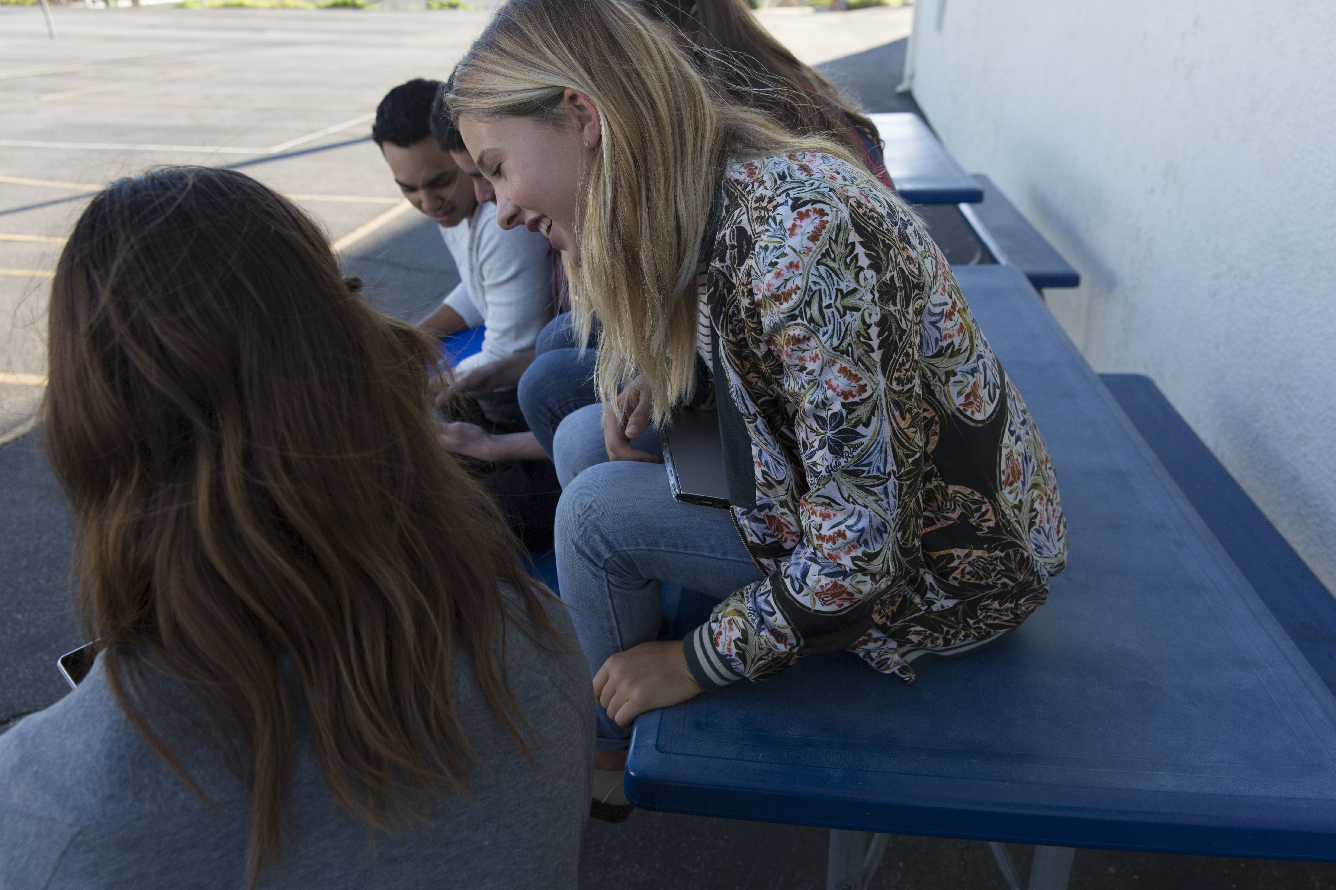
Wrap up
Wrap up
Notes:
SAMPLE SCRIPT:
“Alright everyone! You only have a few more minutes to finish up your tutorial!”
SLIDE GOAL:
To alert participants that time is almost up and the tutorial is almost over.
IMAGE INSTRUCTIONS FOR THIS SLIDE:
For this image we’ve included an .jpg showing a group of friends sharing time and interests. It’s important to include fun and friendship to keep this audience engaged and excited about their experience.
If this image is to be swapped out, make sure it fits the following criteria:
An fun image or .gif of something that signifies the tutorial is almost over and retains the audience interest.

Slide 22
Now what do you think about coding?
When you hear of the term “coding”, what do you think of now?
Question
Notes:
SAMPLE SCRIPT:
“Let’s go back to the conversation we had earlier. Have your thoughts on what coding is changed?”
How will you answer the question “What is code” if your family or a friend asks?
What did you learn?
What was most difficult for you? What did you do when you got stuck? Why is that important? [encourages persistence]
How is coding creative? [connect coding to another way of being creative, like singing, dancing, building.]
Who is coding for? [working to get beyond myths like boys, those good at math, etc.]
SLIDE GOAL:
To return to the initial question, and to see how people’s preconceived notions about coding have changed.
IMAGE INSTRUCTIONS FOR THIS SLIDE:
N/A

Slide 23
What do you want to create?
What do you think you’d want to create that would be fun for you and your friends?
It can be a game, a website, a program, an app - be creative!
Question
Notes:
SAMPLE SCRIPT:
“What do you think you could create with coding? Coding can be applied to anything that you care about.”
*EXAMPLES TO MENTION
If you care about volunteering, you could build a website that helps recruit friends and others to volunteer with them.
If you care about sports can build an app that shows stats of their favorite team.
If you love music, you can create a website that shares weekly playlists and album reviews to share with friends.
SLIDE GOAL:
To re-emphasize that the possibilities are endless when it comes to coding. This is an opportunity to highlight the passions of participants in the room and try and highlight how they can apply coding to what they care about.

Slide 24

Next steps
What can you learn next?
It doesn’t have to end here!
Below are steps you can take to celebrate, keep learning, and have more fun!
1
2
3
Get your cert.
Play more.
Learn more.
Congrats! You did it! You’ll find your certificate at the end of the tutorial.
Upload your code into Minecraft: Education Edition to see your code come to life in the real game!
Explore additional resources at Microsoft.com/
digitalskills
Notes:
SAMPLE SCRIPT:
“Now that you’re on your way to being a coding expert, here are a few free resources for you to check out! Make sure to write down these links, and keep coding!”
SLIDE GOAL:
To encourage young people to take a next step with coding.
FACILITATOR NOTE:
Participants may access their Hour of Code certificates at any time after they have started their Hour of Code tutorial, and after their Hour of CodeTM event, at code.org.
Adjust what is put on additional resource slide by appropriateness for audience:
Participants can upload their code into Minecraft: Education Edition and/or Minecraft on Windows 10 if available.
Participants can use Code Studio to import their code into the real game – and watch their code come to life!
Explore Minecraft: Education Edition:
Minecraft: Education Edition is built for schools, and comes with classroom management tools, lesson plans, and more. For more information, visit https://education.minecraft.net.
Explore ways to bring digital skills, from digital literacy to computer science education, to your community https://Microsoft.com/digitalskills
Code.org (https://code.org/educate) Go beyond an Hour of Code with Code.org's tools for educators. You don't need any experience to start teaching computer science in your classroom. Code.org offers curriculum, lesson plans, high quality professional learning programs, and tons of great tools for all grade levels—everything you need, all at no cost. Go to code.org/educate and choose your grade level to get started!
Code Studio (https://studio.code.org) Did you have fun during the Hour of Code? The world of computer science has a lot more to explore! Code Studio features puzzles, games, and courses for all ages. Learn how to make your own games and apps, and then share them with your friends. Go to studio.code.org and start today!

Slide 25
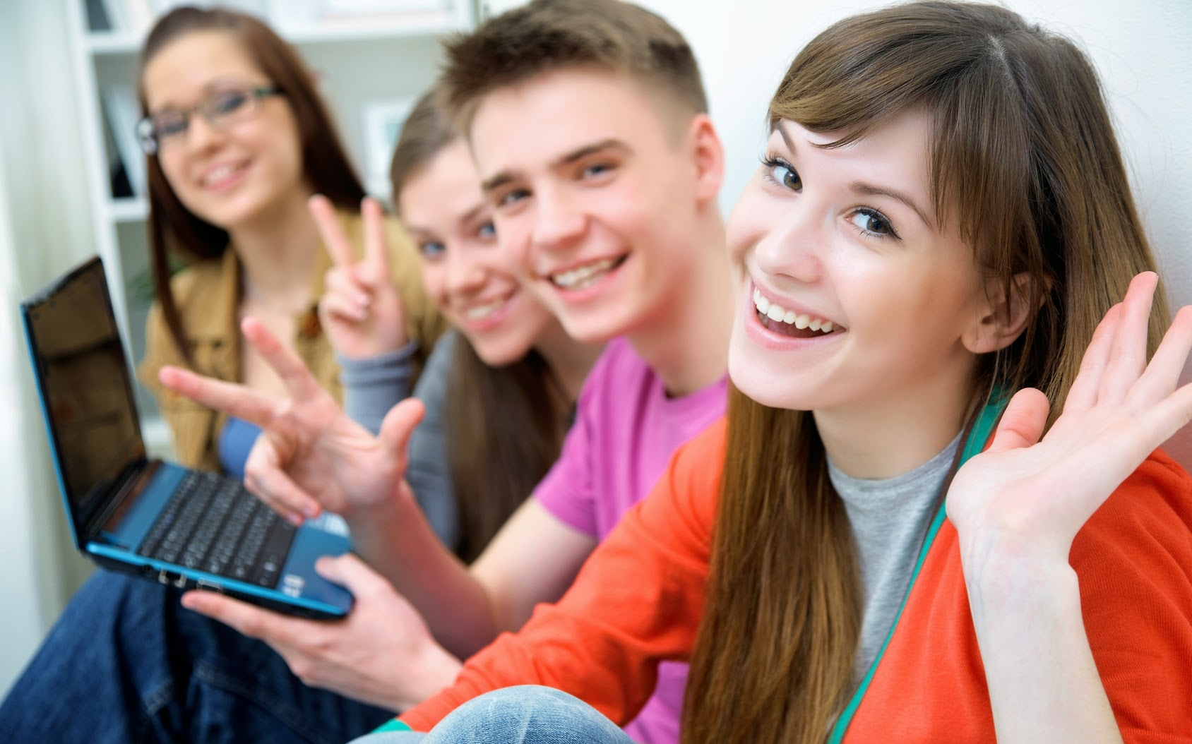
Thanks for joining!
Thank you for joining
Minecraft Hour of Code
Notes:
SAMPLE SCRIPT:
SLIDE GOAL:
To conclude event
IMAGE INSTRUCTIONS FOR THIS SLIDE:
If this image is to be swapped out, make sure it fits the following criteria:
Contains males and females
Shows the participants having a good time
Contains a group of people, not just individuals

Slide 26
Welcome to Hour of Code™
Copyright.
© Code.org, 2018. Code.org®, the CODE logo and Hour of Code® are trademarks of Code.org
Mojang © 2018. "Minecraft" is a trademark of Mojang AB
© 2018 Microsoft Corporation. All rights reserved.
Notes:
Copyright 2017:
This presentation is licensed, not sold. You may not copy, adapt, modify, prepare derivative works of, distribute, publicly display, sell or use this content for commercial purposes without the express prior written consent of Microsoft Corporation.
This presentation is provided to you "as-is". Microsoft makes no warranties, express or implied. Information and views expressed in this presentation, including URL and other Internet Web site references, may change without notice.
Some examples depicted herein are provided for illustration only and are fictitious. No real association or connection is intended or should be inferred.
You may use this presentation for your personal use, and with classrooms and students as part of code.org and other coding events. This presentation does not provide you with any legal rights to any intellectual property in any Microsoft product.
Microsoft and the trademarks listed at http://www.microsoft.com/en-us/legal/intellectualproperty/trademarks/en-us.aspx are trademarks of the Microsoft group of companies. All other marks are property of their respective owners.
© Code.org, 2016. Code.org®, the CODE logo and Hour of Code® are trademarks of Code.org
Mojang © 2016. "Minecraft" is a trademark of Mojang AB
© 2016 Microsoft Corporation. All rights reserved.

